Slide 1
Kernel-Based Image Processing
ANDREW PRATA, JR. | 12/04/23

Slide 2
AGENDA
Project Overview
Kernel Convolution Explanation
Functionalities Implemented
Mean Blur
Gaussian Blur
Inversion
Sobel Operator
Laplacian Operator
Histogram Equalization
Median Filtration
Conclusions and Lessons Learned

Slide 3
PROJECT OVERVIEW
Initial scope: implement traditional edge-detection algorithm
Scope grew over time, standard edge detection is not exceedingly difficult to design
Experimented with other kernel-based processing techniques (blurs, filters, etc.)
Designs implemented:
Gaussian blur, mean blur, Sobel operator, Laplacian operator, inversion, histogram equalization, median filtration

Slide 4

KERNEL CONVOLUTION
Basis of many image processing techniques: convolution
Kernel: “grid” that is convolved with the input image (also just a “grid”)
Contains filter information
Basic explanation:
Kernel “overlaid” on input image, centered on one pixel
Each value in the kernel is multiplied with the value it overlaps from the input, these are then summed
This sum is the output pixel; repeat for all input pixels
Convolution Visualized
Source: Wikipedia

Slide 5
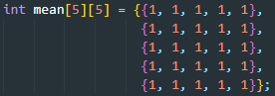
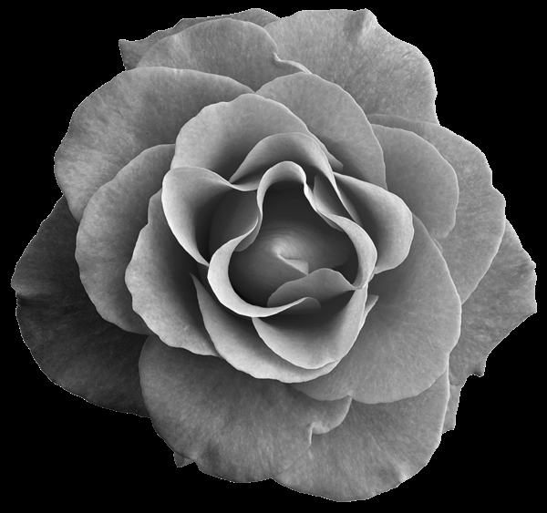

MEAN BLUR
Kernel of all “1”, equal weighting of all pixels in kernel region
Causes a true averaging of all pixel values
Raw Grayscale Image 5x5 Mean Blur

Slide 6
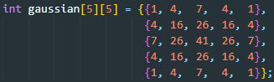
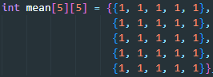

GAUSSIAN BLUR
Kernel constructed from discrete Gaussian distribution
Weights origin pixel heavier than neighbors
Raw Grayscale Image 5x5 Gaussian Blur

Slide 7
BLUR COMPARISON
Gaussian blur preserves edges, but still softens the image
Mean blur is generally not edge preserving, and simply blurs the entire image
Raw Grayscale Image 5x5 Gaussian Blur 5x5 Mean Blur

Slide 8
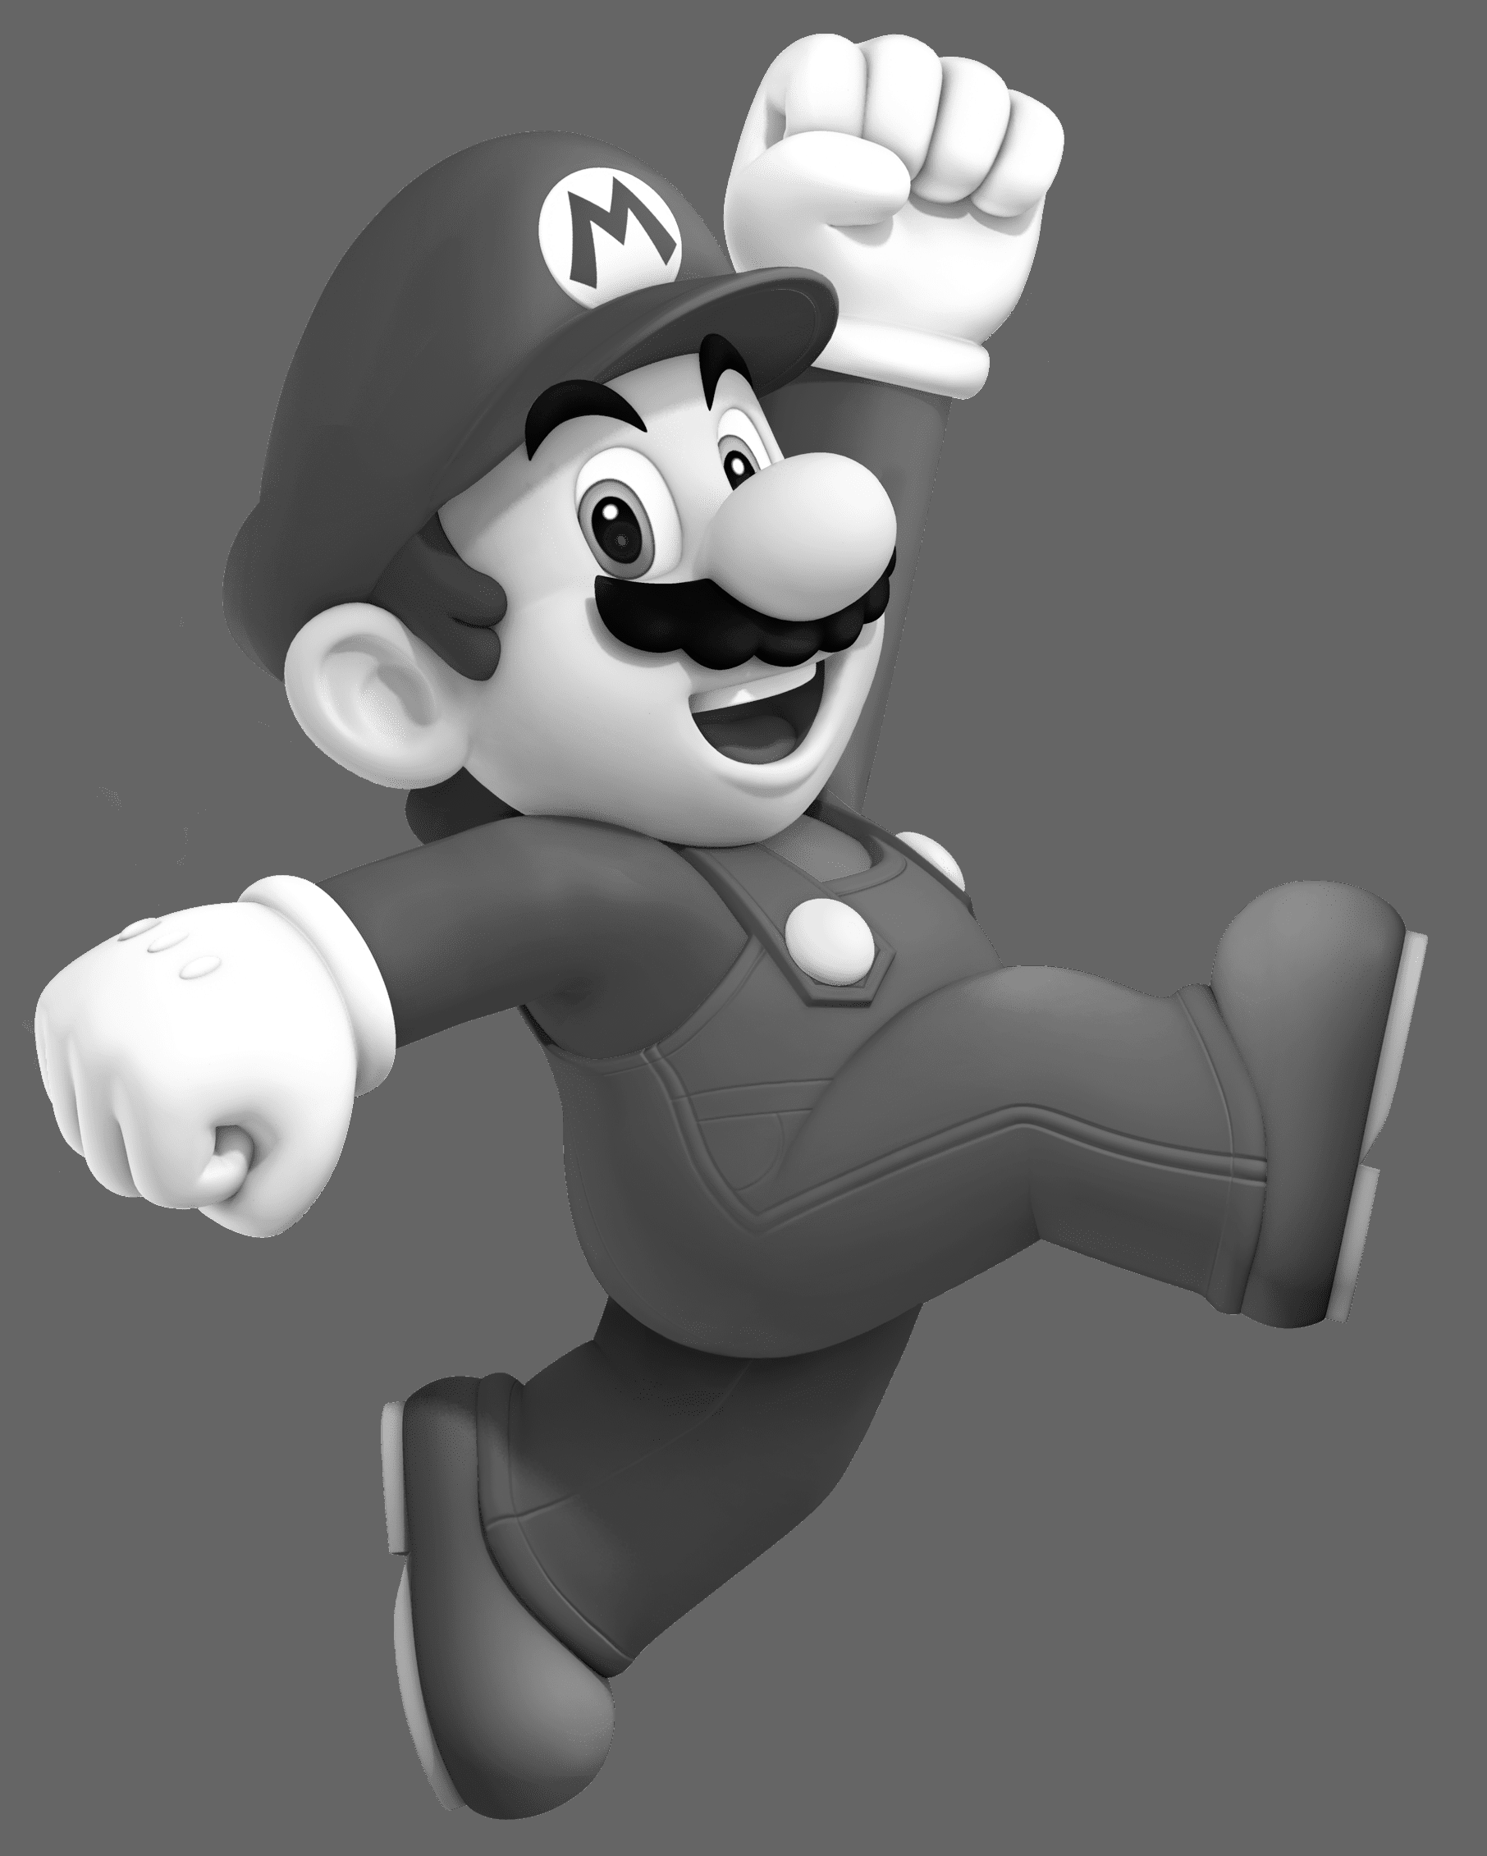
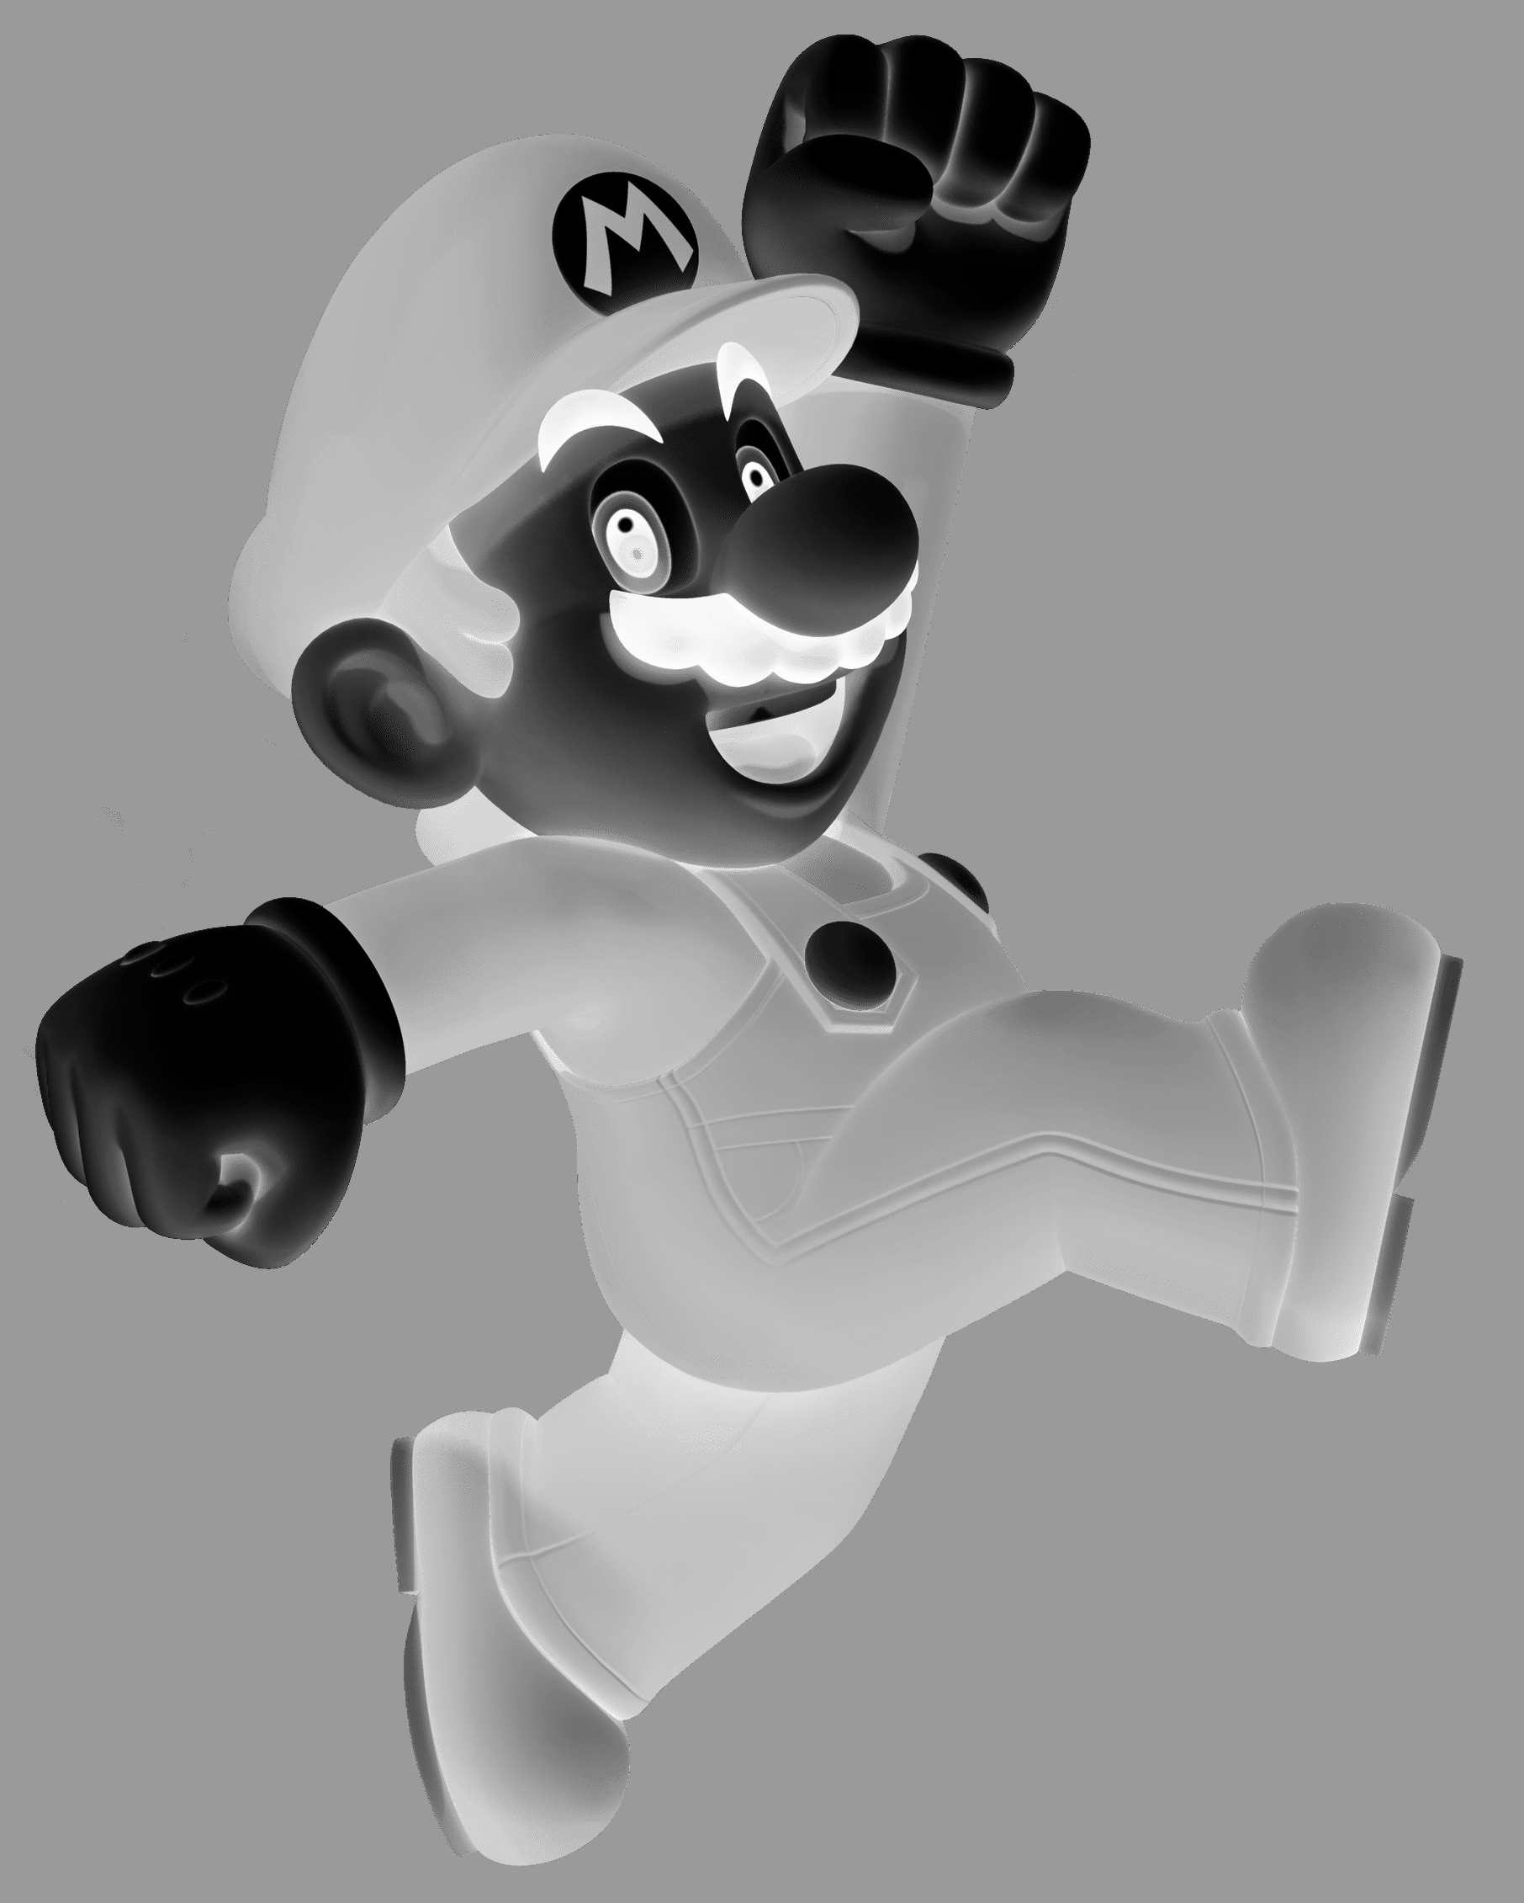
INVERSION
Does not require kernel-based processing, simple subtraction: newVal = 255 - val
Used to make other functions easier to see
Raw Grayscale Image Intensity Inversion

Slide 9
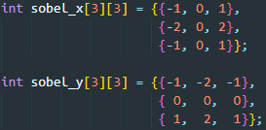
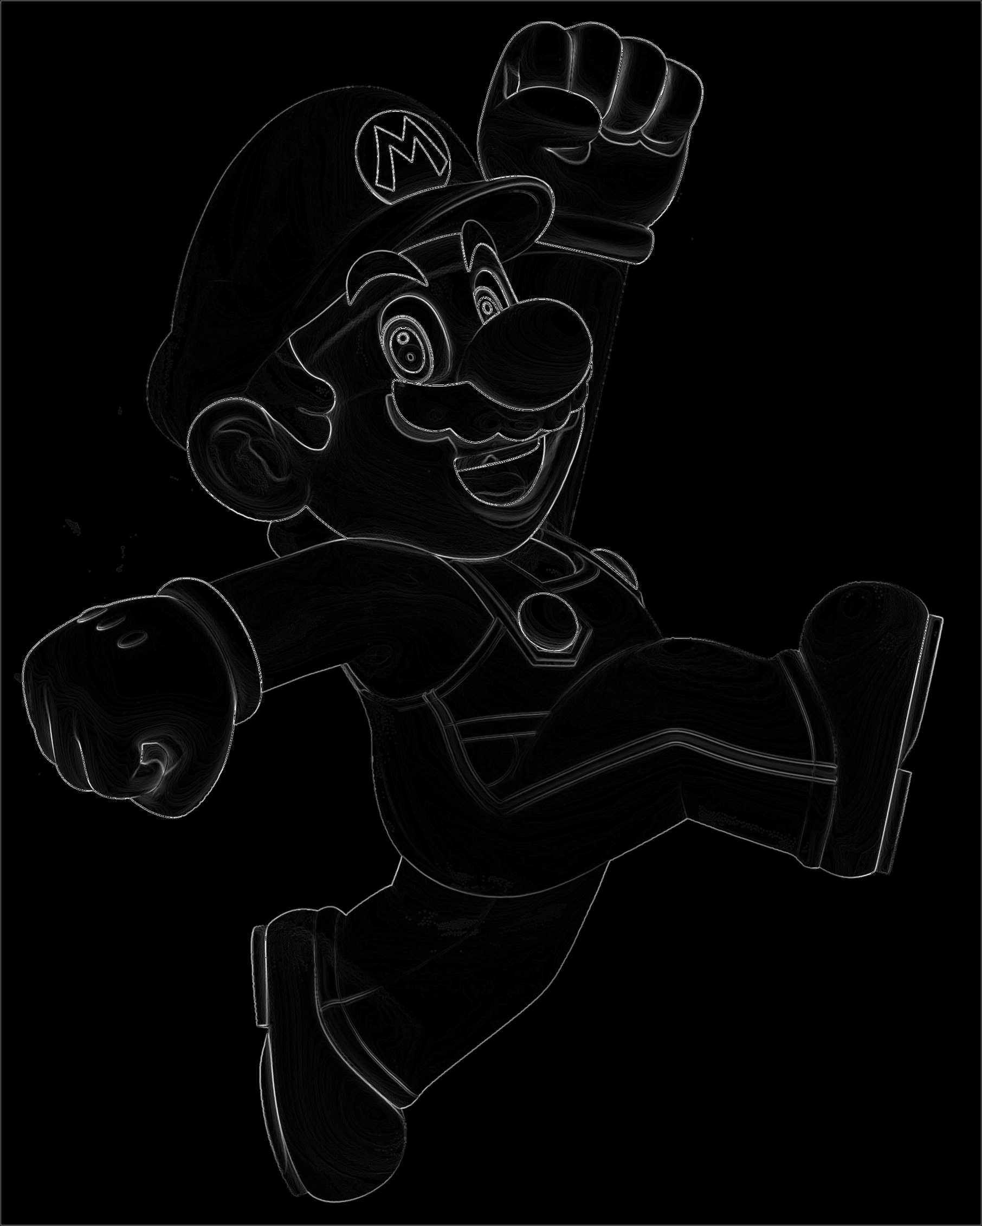
SOBEL OPERATOR (EDGE DETECTION)
Emphasizes difference between {top, bottom} of origin (y-direction), and {left, right} of origin (x-direction)
Compute magnitude of both x and y convolution sums for output
Raw Grayscale Image Sobel Operator Result (No Tuning)

Slide 10
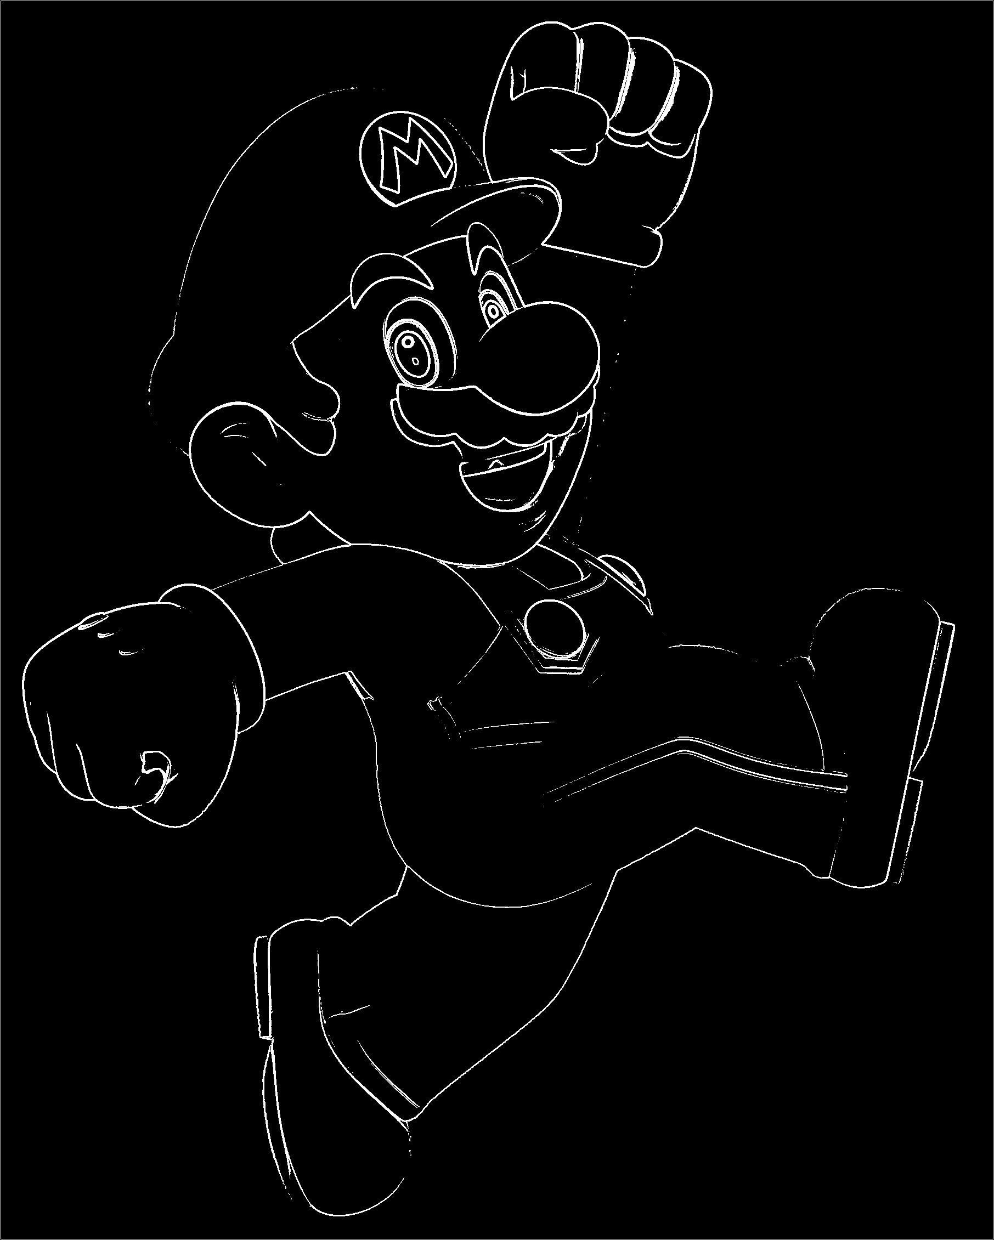



SOBEL OPERATOR (TUNING ENHANCEMENT)
Threshold Intensity 56, Binary Output
Threshold Intensity 48
Raw
Binary
Variable
Raw Processed

Slide 11
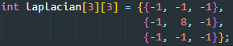
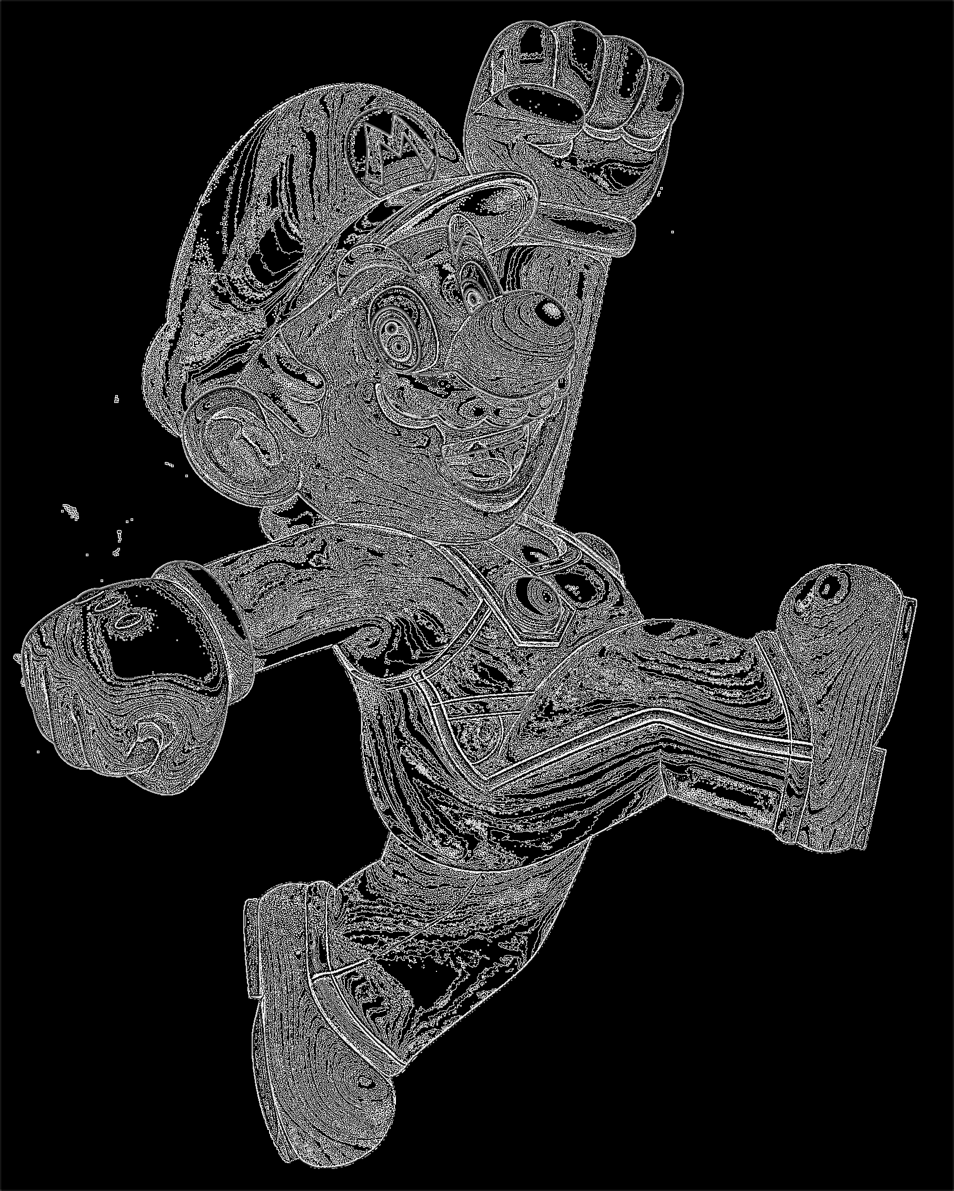
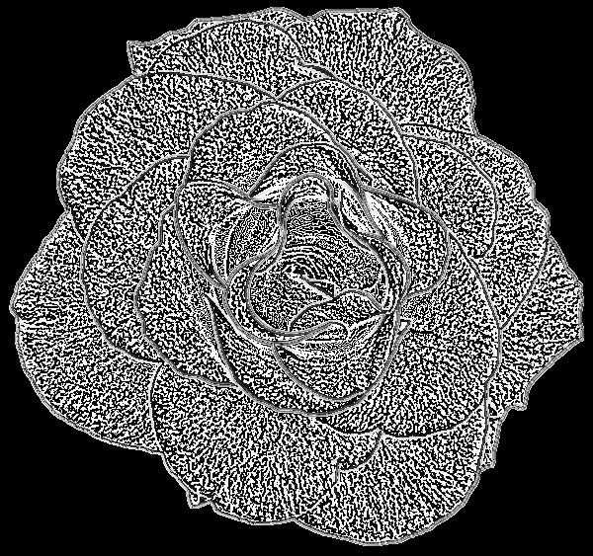

LAPLACIAN OPERATOR
Detects changes in intensity from origin to neighbors (effectively edge detection)
In my testing, seems to detect “contours” well - see samples:
Apparent contour lines at intensity shifts

Slide 12
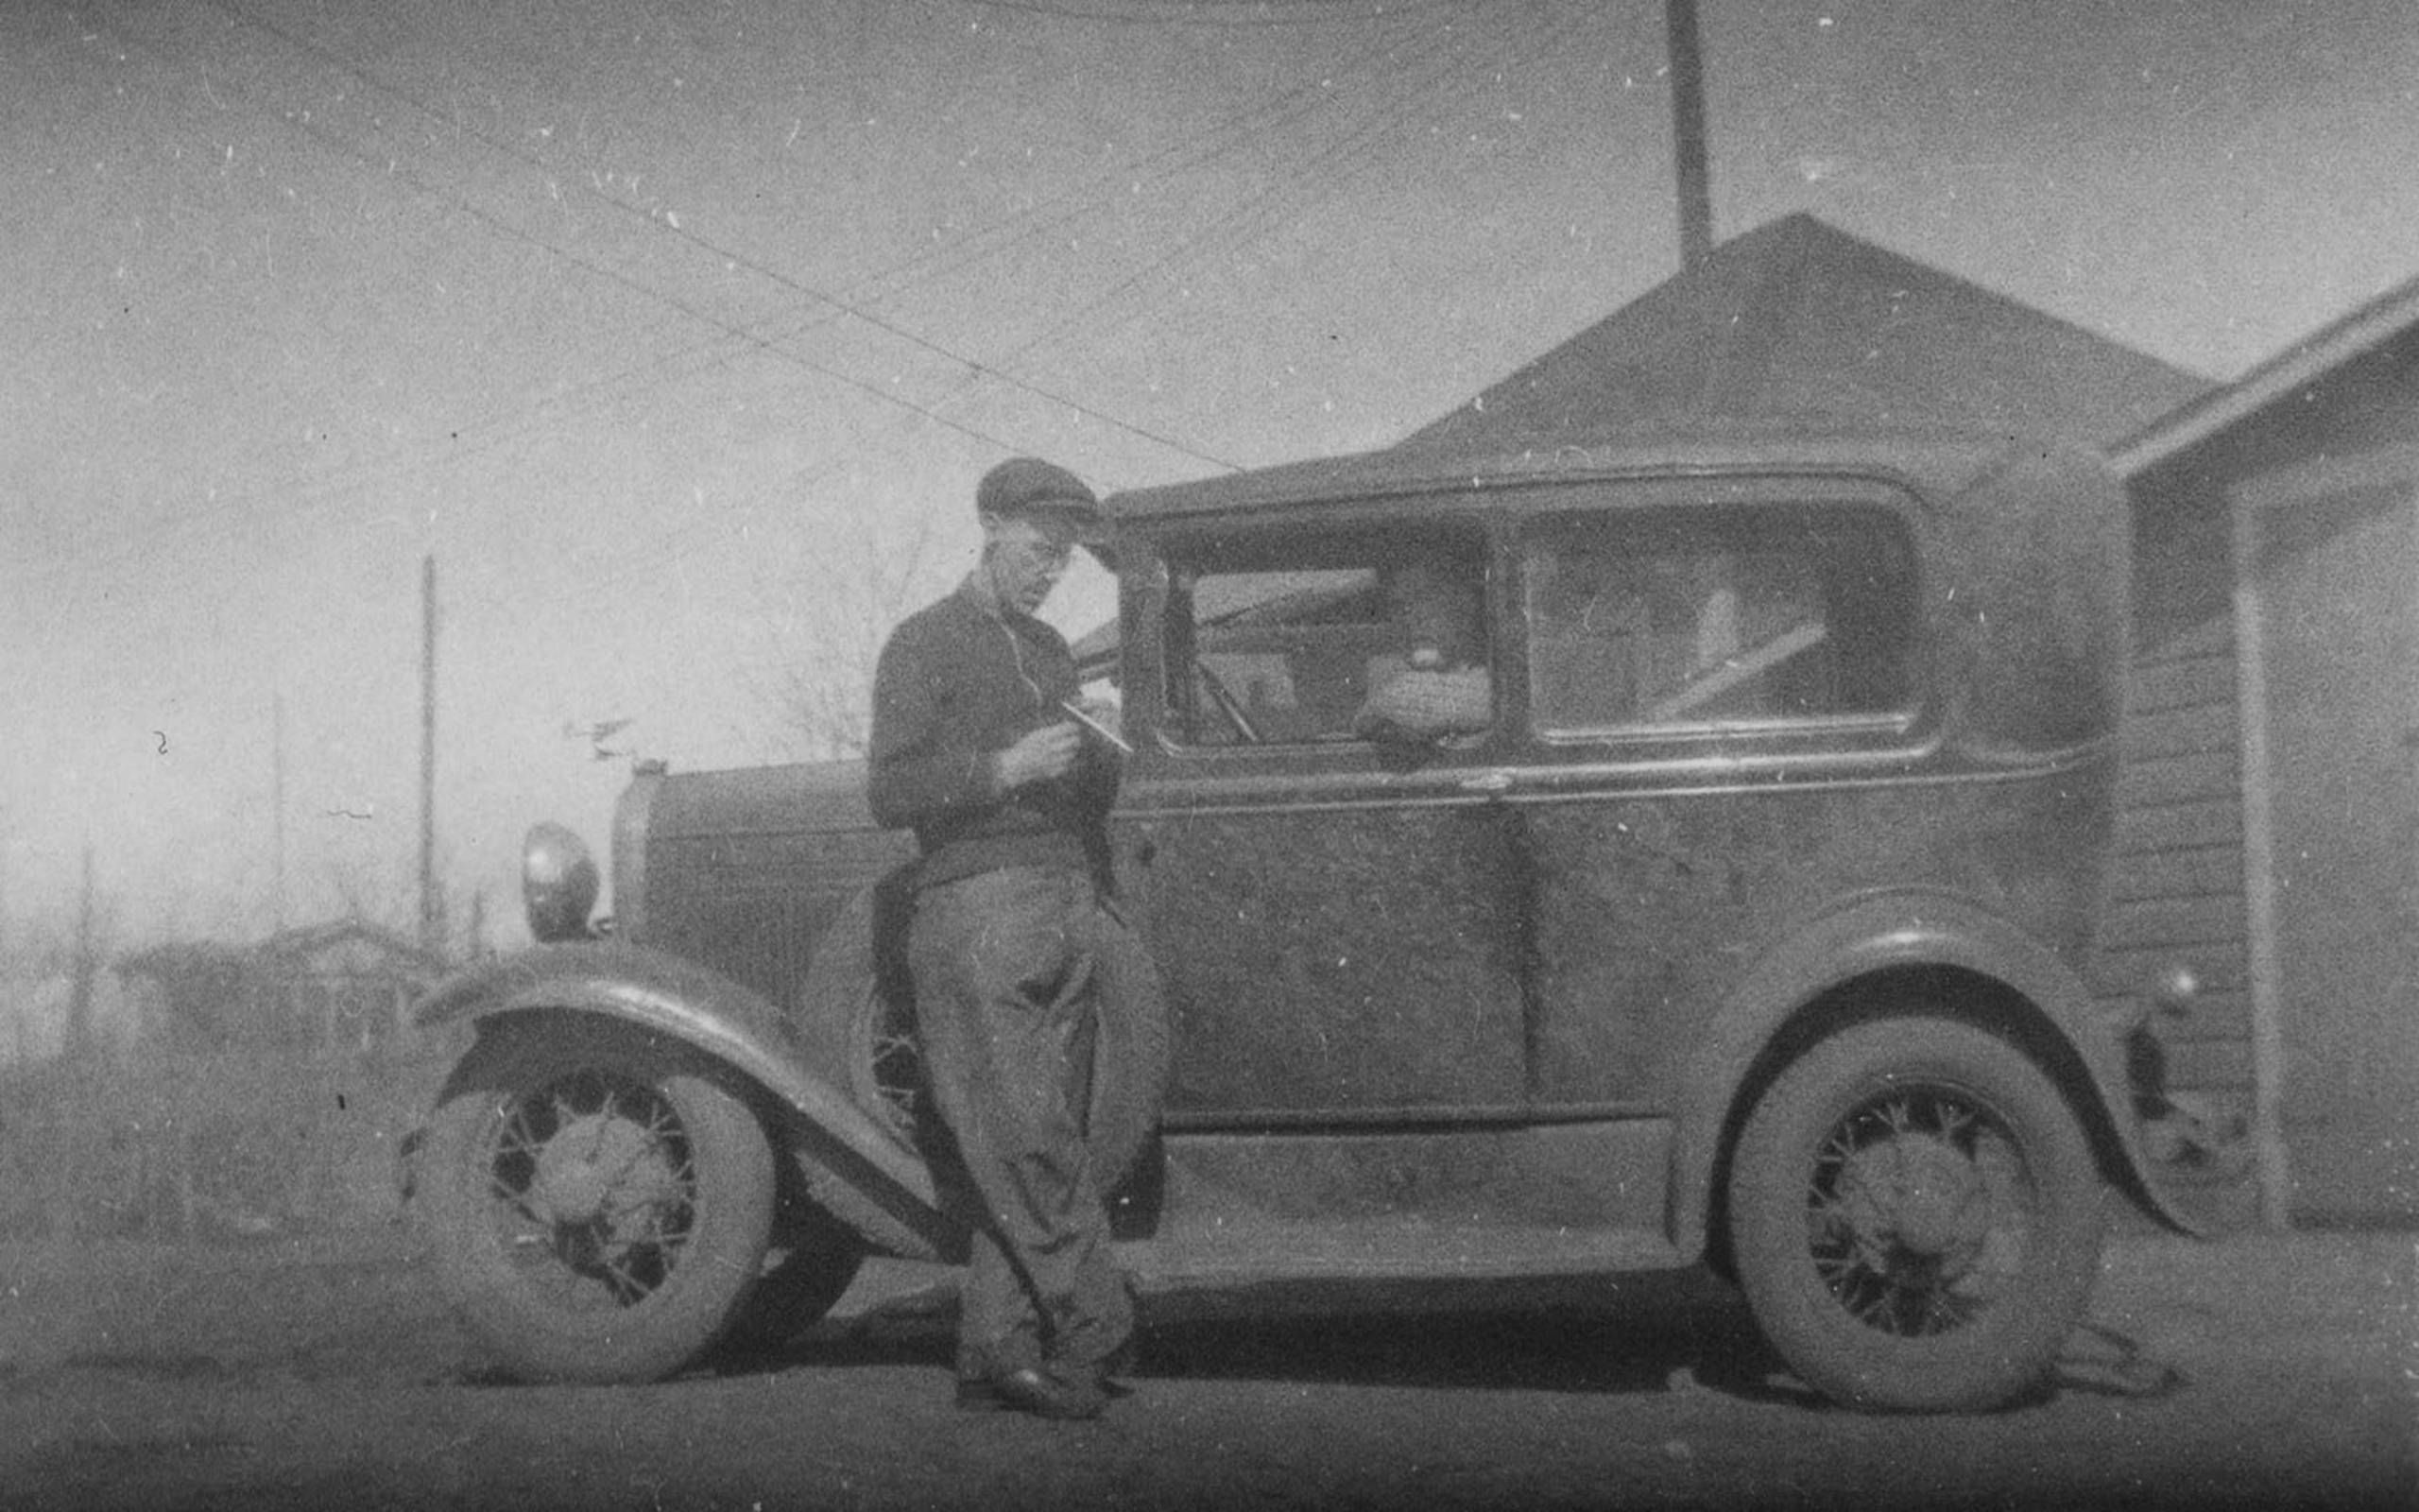
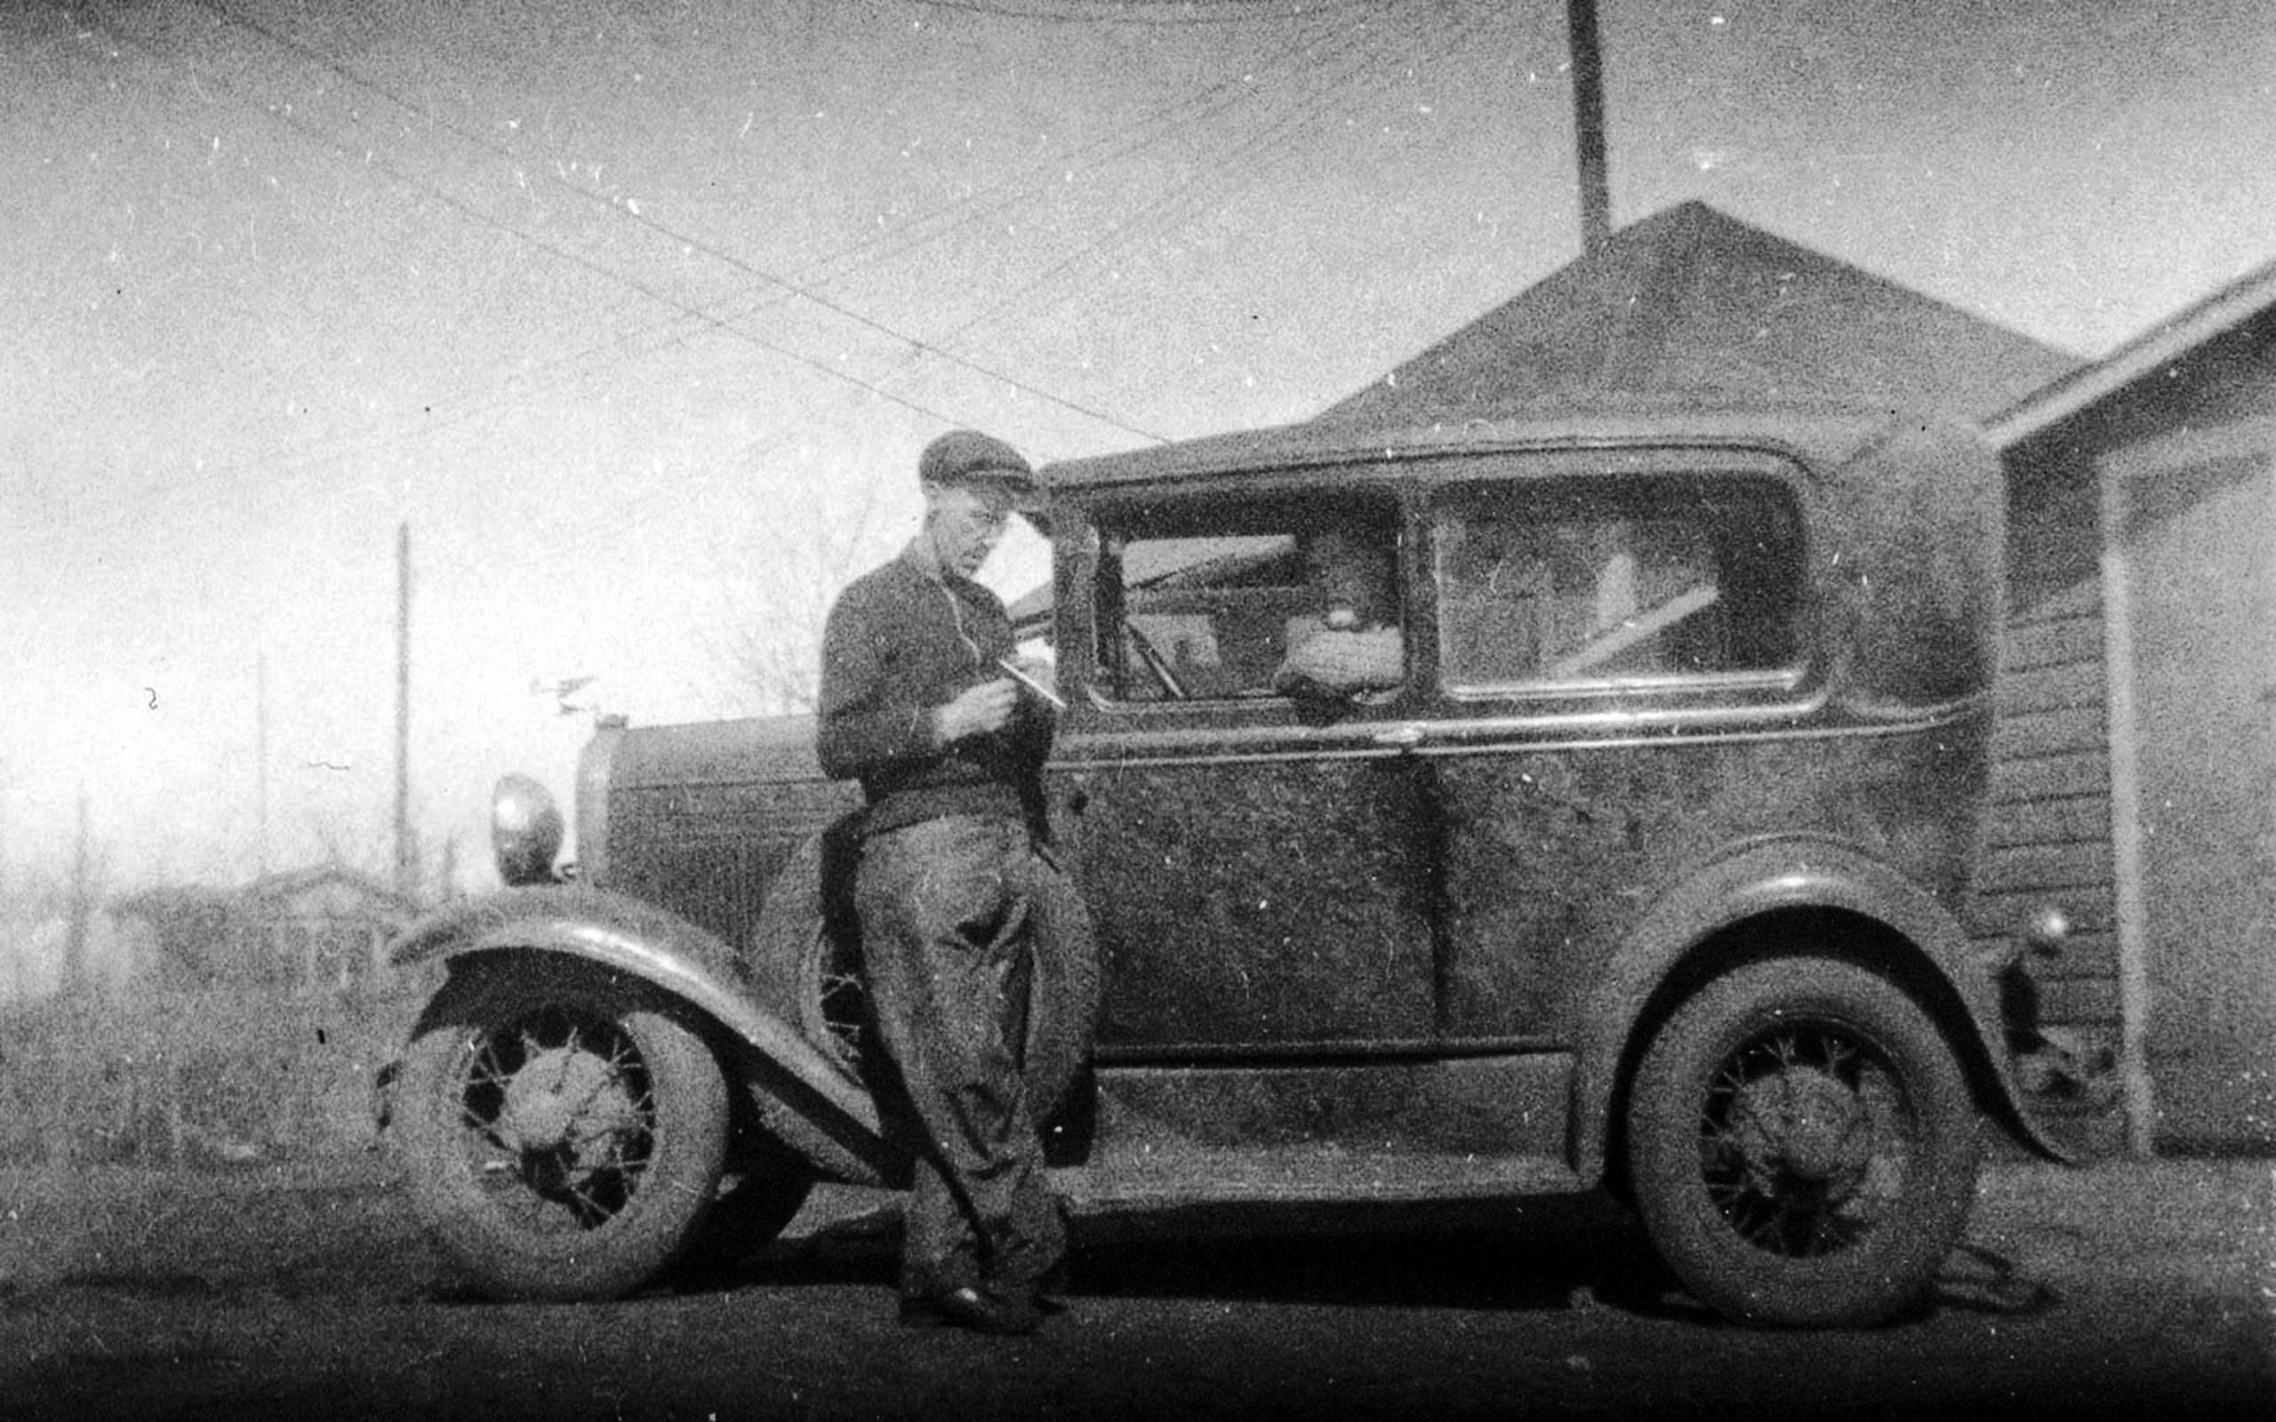
HISTOGRAM EQUALIZATION (SATURATION)
Form a histogram of intensity values (count vs. intensity plot)
Create an accumulated histogram, which is just the summation of the histogram at each point (Cumulative Distribution Function, or CDF)
Normalize the accumulated histogram over the range of intensities (0-255)
Use to re-map intensities of original image
Raw Grayscale Image Histogram Equalization

Slide 13
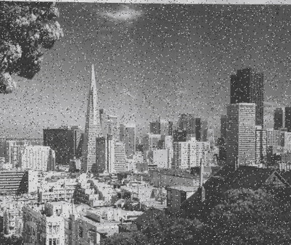
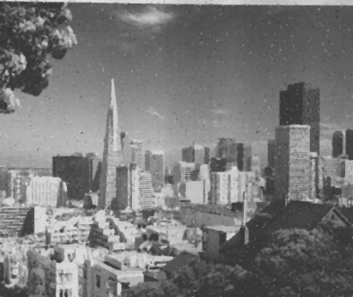
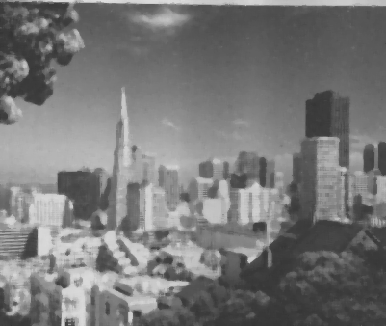

MEDIAN FILTRATION
The Median Filter establishes a neighborhood of size [(2 * Radius + 1)^2] centered on the origin pixel
Determine and sort the intensities of this pixel neighborhood, and output is the median value (I wonder why it is called “Median Filter?”)
Destroys salt-and-pepper noise typically observed in old photographs, trade-off with sharpness
Raw MF, Radius 1 MF, Radius 2 MF, Radius 3

Slide 14

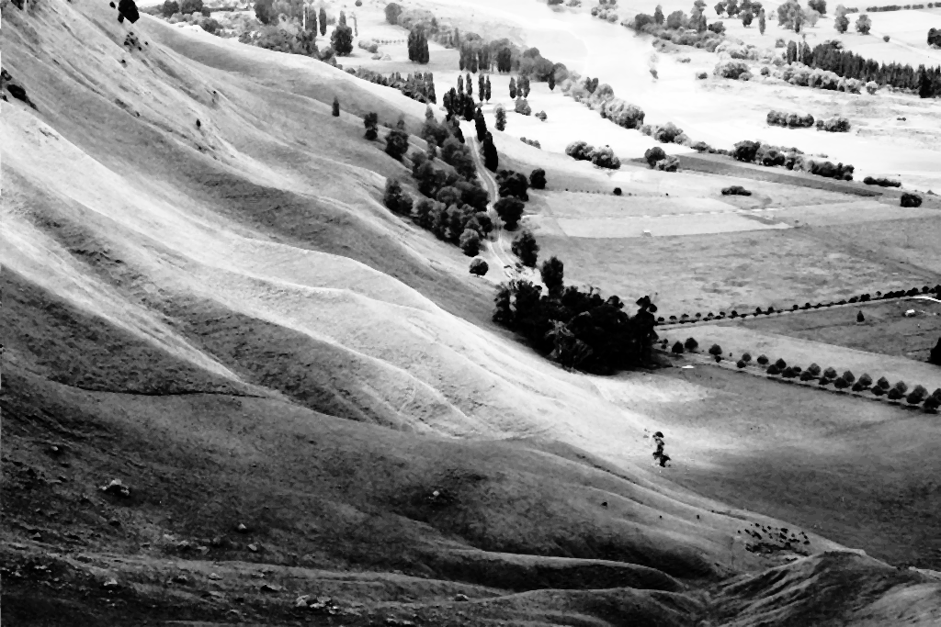
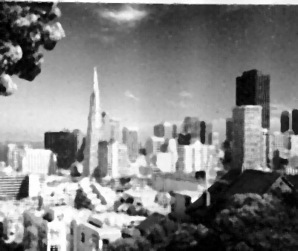
A POWERFUL COMBINATION…
Combining Median Filtration and Histogram Equalization can be powerful for restoration of corrupted images
Requires tuning: Which to apply first? What size median window? Can be successful: see examples.
Landscape, Before Landscape, After City, Before City, After

Slide 15
CONCLUSIONS
Before this project, I had effectively no idea how image processing was done
I got to learn foundational elements based in kernel convolution
Blurs
Filters
Edge Detection
I also used a few algorithmic processing methods, from basic inversion to histogram equalization
I was impressed how little code is required to completely transform an image for the better, or extract useful features like edges
Tuning outputs and experimenting with different kernels was a rewarding and fun experience

Slide 16

Thank you for your attention! Questions?
All source code, images, and references are available at https://github.com/apratajr/AdvancedComputerSystems/tree/main/Final

